Slide 1
PhD Interview: Skoltech
DIVINE OKEKE
17 August, 2023

Slide 2






Academic, career history, and Awards
2
University of Nigeria, Nsukka
B.Eng Electrical Engineering
University of Nigeria, Nsukka
Masters in Automatic Control Systems.
Skolkovo Institute of Science and Technology
MSc. Energy Systems.
Graduate Assistant,
Federal Polytechnic Nasarawa, Nigeria
Research Intern,
CEST, Skoltech
Industrial Immersion at Siberian Generating Company
The World Bank African Centre of Excellence Scholarship
Best graduating student award for MSc Automatic Control Systems
Skoltech MSc. Scholarship

Slide 3
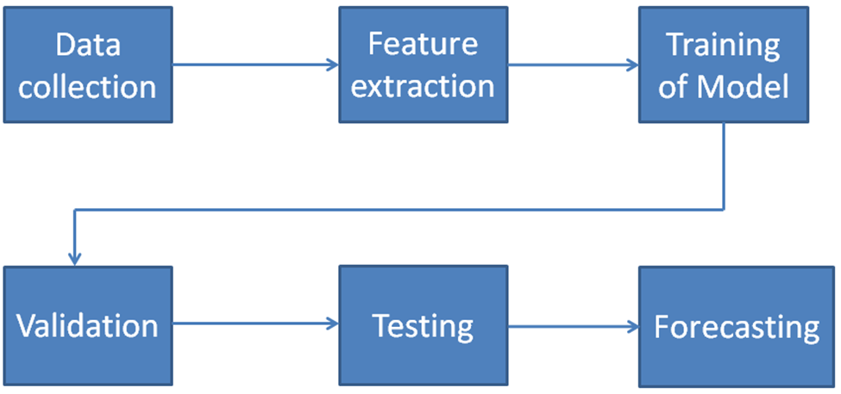
Previous Research
3
Enhancing Solar Power Forecasting Accuracy using Long Short Term Memory Deep Learning Algorithm and Feature Extraction
Aim:
Develop an accurate power output prediction model for solar PV systems to aid control engineers in optimizing grid operations, particularly in developing countries where meteorological data may be scarce.
The problem:
Integrating solar PV into the grid poses challenges due to the variable power output. Predicting solar PV power output is crucial for optimizing grid operations. However, in developing countries, meteorological data required for accurate predictions are often unavailable.

Slide 4
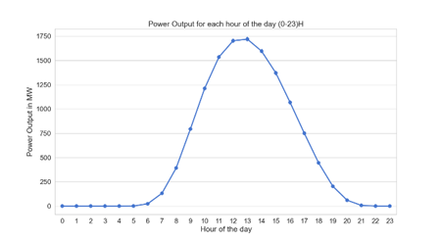

Previous Research
4
Results
Error Type | Proposed Model | Reference Model
RMSE | 0.0075 | 0.0445
MAE | 0.0038 | 0.0368
BIAS | 5.6771e-05 | 0.2786
AbsDev | 9.8781e-07 | 0.0073
Submitted to:
IEEE Transactions on Sustainable Energy
Hourly Magnitude of Output Power (Summed Across the Years)

Slide 5
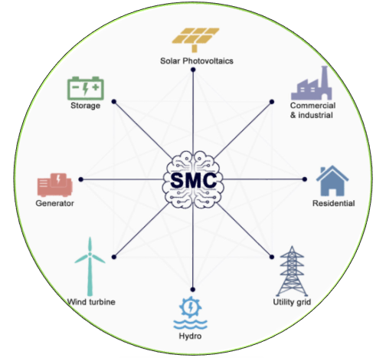
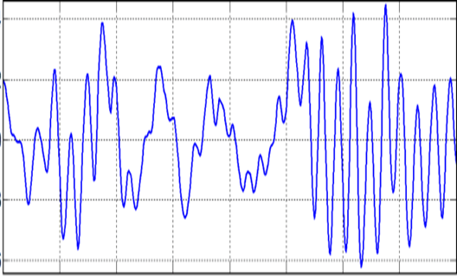
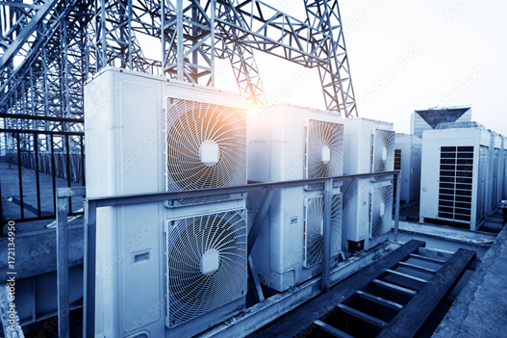
Current Research
5
Title: Grid voltage and frequency improvements using thermostatic controlled loads in micro-grids
Problem:
Micro-grids are gaining popularity for local electricity generation, reducing reliance on the main grid. However, unstable voltage and frequency pose a challenge to their adoption. While energy storage and backup generators are potential solutions, they may not be feasible for all micro-grids. Thermostatically controlled loads offer a promising solution by adjusting energy usage to grid changes and regulating voltage and frequency.
micro-grids.
voltage and frequency
Aim:
The objective is to assess the viability of utilizing thermostatically controlled loads for enhancing grid stability in micro-grids.
Thermostatically controlled loads

Slide 6
Current Research
6
Grid
Voltmeter
PLL
Comparator
Amplifier
Comparator
Amplifier
Voltmeter
PLL
micro-grids.
TCL
Computer program for voltage/freq. control
Droop controller
Building controllable variables (eg. Room temp.)

Slide 7
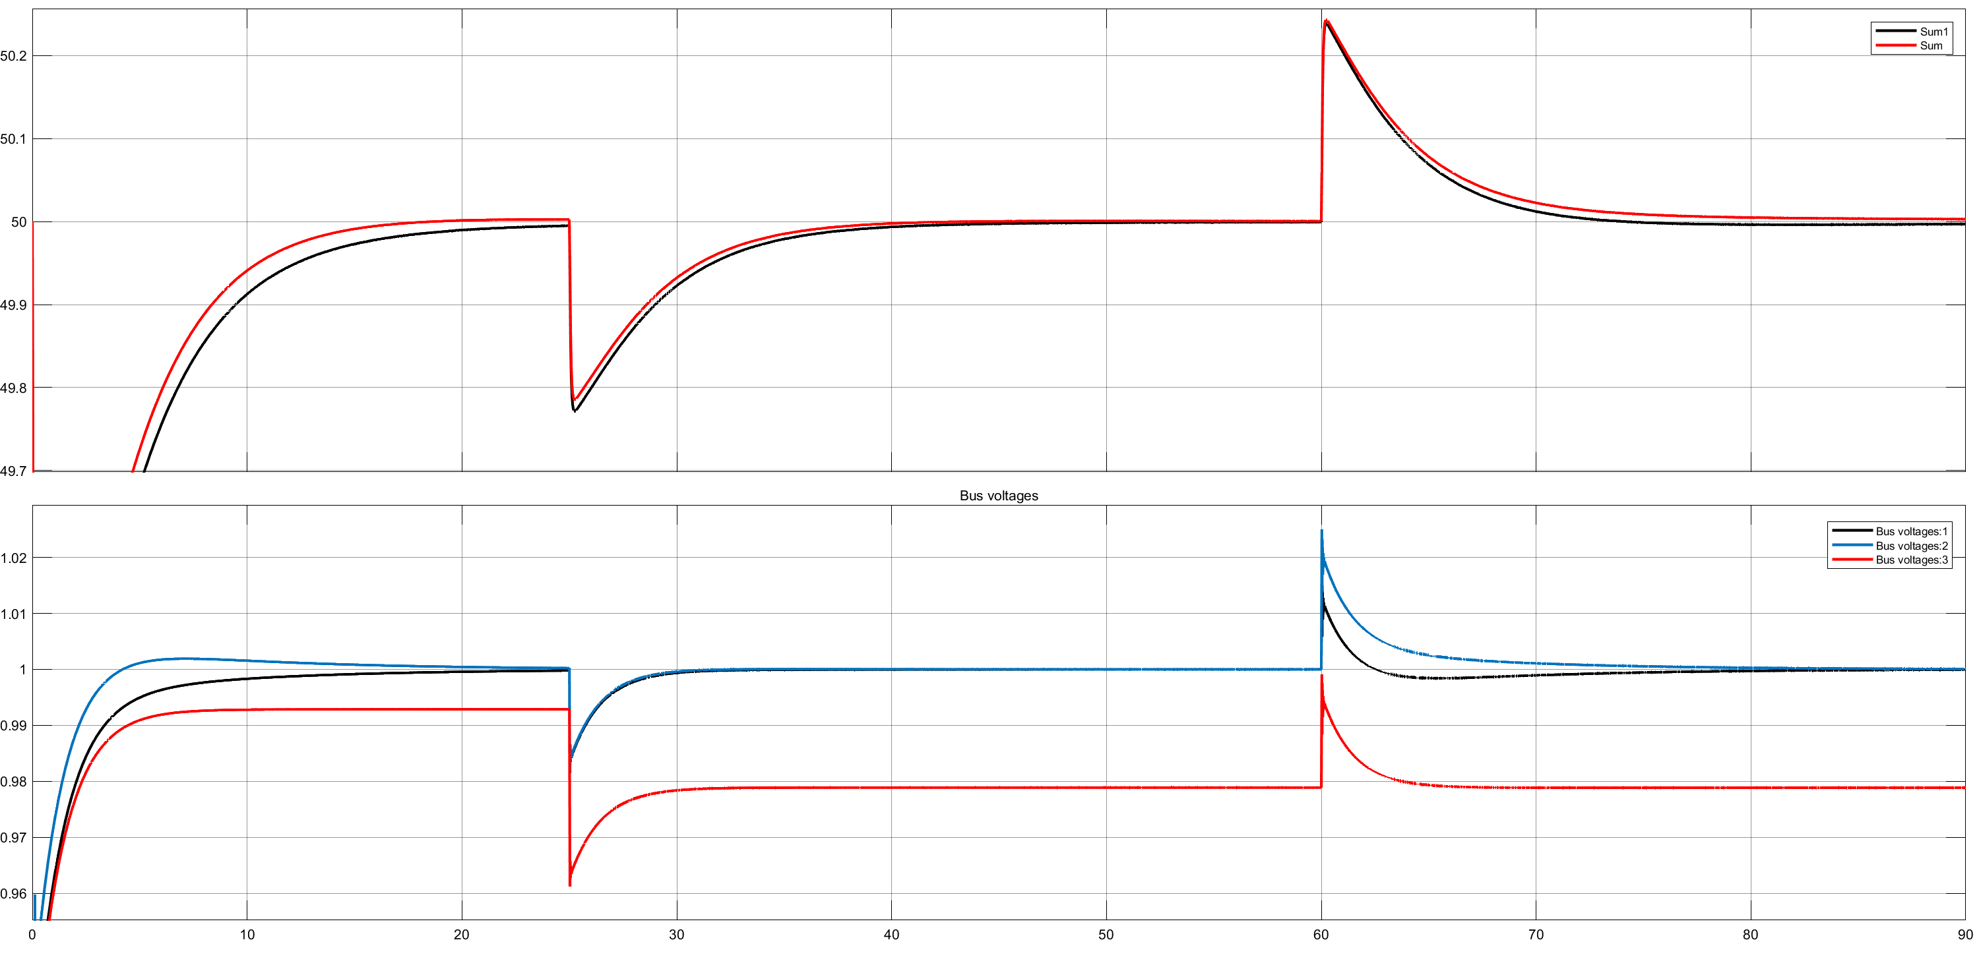
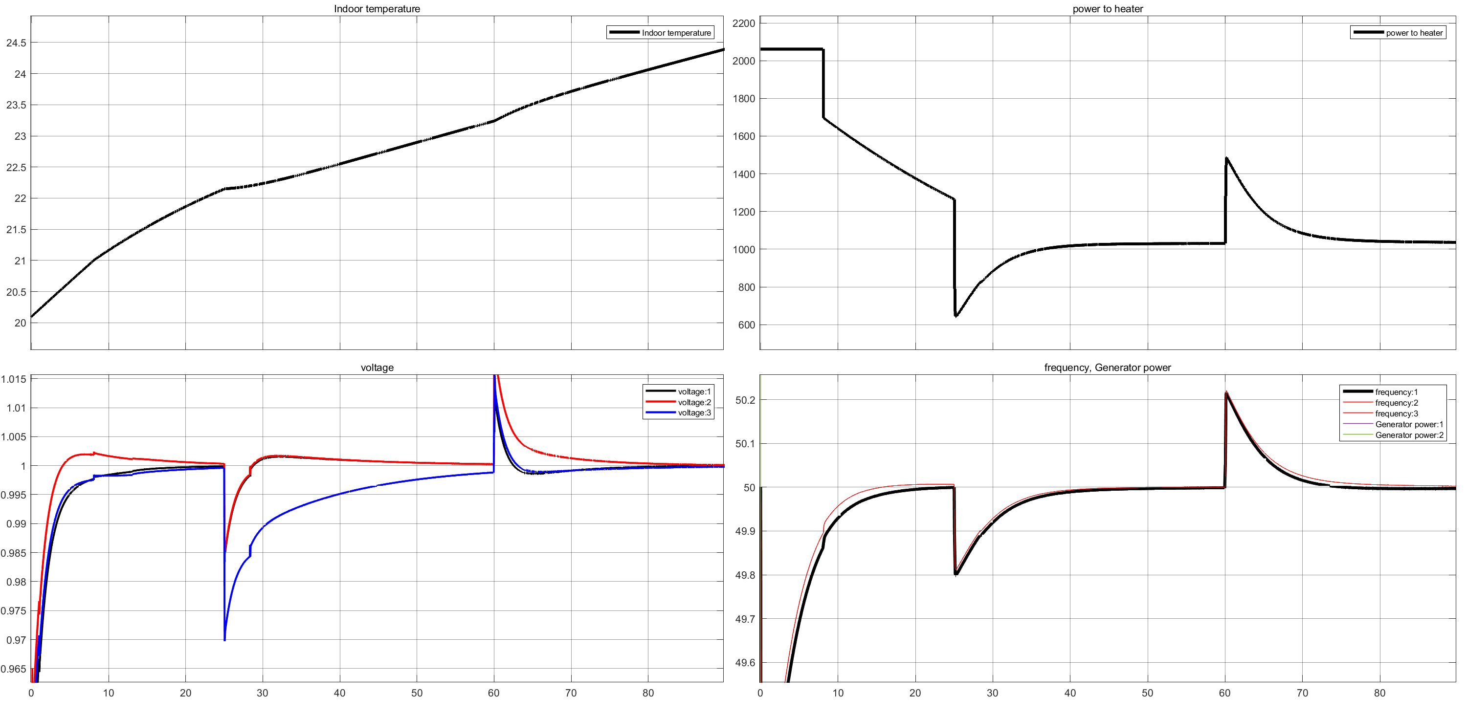
Current Research
7
Result
(a)
(a)
Heater power (W)
Frequency (hz)
Indoor temperature
(b)
(b)
(c)
Frequency (hz)
Voltage (p.u.)
Voltage (v)
Bus 1
Bus 2
Bus 3
(d)
time(s)
time(s)
Simulation Results without TCL (a) Grid frequency (b) Grid voltage
Simulation Results with TCL (a) Indoor Temperature (b) Power of Heater (c) Grid voltage (d) Grid frequency

Slide 8
Research Proposal
8
Title: Distributed Control Strategies for Smart Distribution Grids with High Penetration of Renewable Energy
Proposed supervisor: Federico Martin Ibanez
The Problem:
As renewable energy grows, smart distribution grids face challenges in grid stability, power quality, resource utilization, and communication coordination. Effective control strategies and robust communication architectures are needed for addressing these issues.

Slide 9
Research Proposal
9
Work plan
Literature Review
Development of Distributed Control Algorithms
Integration of Renewable Energy Sources
Power Quality Improvement
Communication and Coordination
Potential impact
The outcomes of the research will provide valuable insights and guidance for achieving grid stability, power quality improvement, efficient resource utilization, and seamless communication in future energy systems with a high penetration of renewable energy.

Slide 10
Why Skoltech?
10
Entrepreneurship
Finalist Skoltech Triplepoint
Science
Innovation
Laboratory
Innovation workshop
Winner of the MIT Startup Lab.
Technology
Real-time Simulators
Participant of the Megagrant project

